Slide 1
Artificial intelligence
Lecture-2
Intelligent agents
Syed Zubair ali

Slide 2
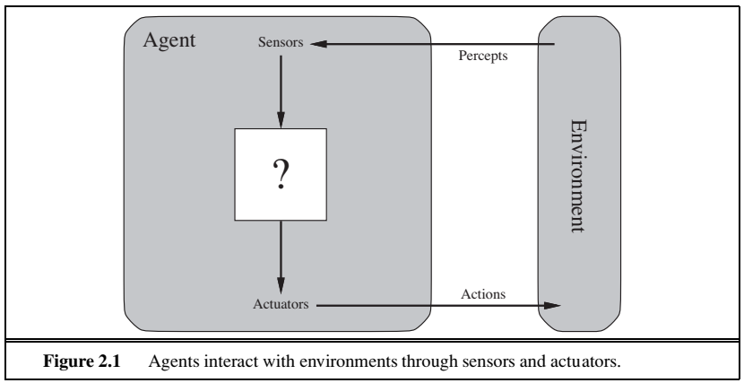
Intelligent agents
An agent is anything that can be viewed as perceiving its environment through sensors and

Slide 3
Intelligent agents
vacuum-cleaner world
the vacuum-cleaner world shown in the Figure.
This world is so simple that we can describe everything that happens.
This particular world has just two locations: squares A and B.
The vacuum agent perceives which square it is in and whether there is dirt in the square.
It can choose to move left, move right, suck up the dirt, or do nothing.
One very simple agent function is the following: if the current square is dirty, then suck; otherwise, move to the other square.

Slide 4
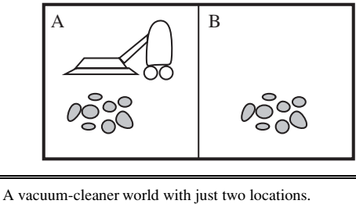
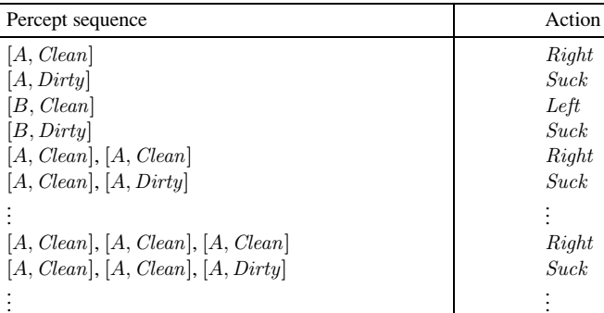
Intelligent agents

Slide 5
Intelligent agents
A rational agent is one that does the right thing—conceptually speaking, every entry in the table for the agent function is filled out correctly.
Obviously, doing the right thing is better than doing the wrong thing, but what does it mean to do the right thing?
• The performance measure that defines the criterion of success.
• The agent’s prior knowledge of the environment.
• The actions that the agent can perform.
• The agent’s percept sequence to date.
This leads to a definition of a rational agent:

Slide 6
Intelligent agents
Be careful to distinguish between rationality and omniscience.
An omniscient agent knows the actual outcome of its actions and can act accordingly; but omniscience is impossible in reality.
Example: I am walking along the Champs Elys´ ees one day and I see an old friend across the street. There is no traffic nearby and I’m not otherwise engaged, so, being rational, I start to cross the street. Meanwhile, at 33,000 feet, a cargo door falls off a passing airliner,2 and before I make it to the other side of the street I am flattened. Was I irrational to cross the street? It is unlikely that my obituary would read “Idiot attempts to cross street.”
This example shows that rationality is not the same as perfection. Rationality maximizes expected performance, while perfection maximizes actual performance

Slide 7
Intelligent agents
A rational agent not only to gather information but also to learn as much as possible from what it perceives.
The agent’s initial configuration could reflect some prior knowledge of the environment, but as the agent gains experience this may be modified and augmented.
There are extreme cases in which the environment is completely known a priori.
To the extent that an agent relies on the prior knowledge of its designer rather than
on its own percepts, we say that the agent lacks autonomy.
A rational agent should be autonomous—it should learn what it can to compensate for partial or incorrect prior knowledge.

Slide 8
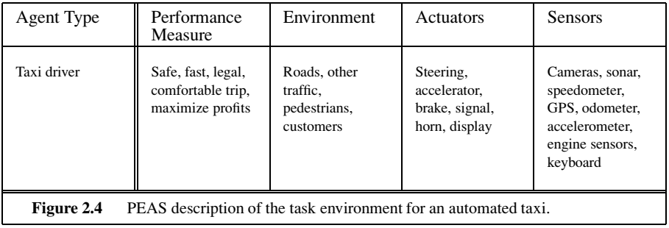
Intelligent agents
In the rationality of the simple vacuum-cleaner agent, the performance measure, the environment, the agent’s actuators and sensors were specified. All these are grouped under the heading of the task environment.
PEAS (Performance, Environment, Actuators, Sensors)

Slide 9
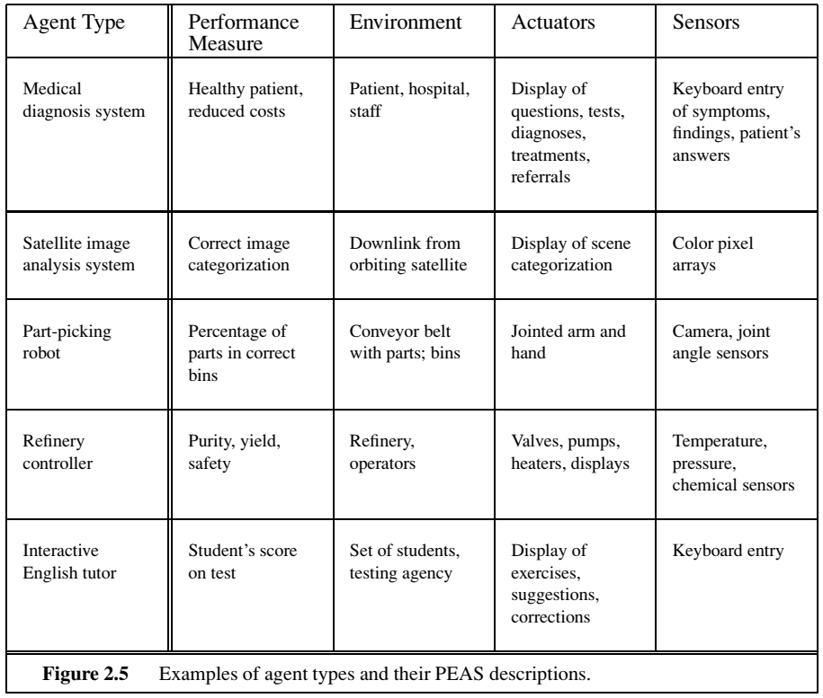
Intelligent agents

Slide 10
Intelligent agents
If an agent’s sensors give it access to the complete state of the environment at each point in time, then the task environment is fully observable.
A task environment is effectively fully observable if the sensors detect all aspects that are relevant to the choice of action; relevance, in turn, depends on the performance measure.
An environment might be partially observable because of noisy and inaccurate sensors or because parts of the state are simply missing from the sensor data—for example, a vacuum agent with only a local dirt sensor cannot tell whether there is dirt in other squares, and an automated taxi cannot see what other
drivers are thinking.
If the agent has no sensors at all then the environment is unobservable.

Slide 11

Intelligent agents
An agent solving a crossword puzzle by itself is clearly in a single-agent environment, whereas an agent playing chess is in a two-agent environment.
In chess, the opponent entity B is trying to maximize its performance measure, which, by the rules of chess, minimizes agent A’s performance measure. Thus, chess is a competitive multiagent environment.
In the taxi-driving environment, on the other hand, avoiding collisions maximizes the performance measure of all agents, so it is a partially cooperative multiagent environment.

Slide 12
Intelligent agents
If the next state of the environment is completely determined by the current state and the action executed by the agent, then we say the environment is deterministic; otherwise, it is stochastic.
If the environment is partially observable, however, then it could appear to be stochastic.
Most real situations are so complex that it is impossible to keep track of all the unobserved aspects; for practical purposes, they must be treated as stochastic.
Taxi driving is clearly stochastic in this sense, because one can never predict the behavior of traffic exactly.

Slide 13

Intelligent agents
In an episodic task environment, the agent’s experience is divided into atomic episodes. In each episode the agent receives a percept and then performs a single action. Crucially, the next episode does not depend on the actions taken in previous episodes.
For example, an agent that has to spot defective parts on an assembly line bases each decision on the current part, regardless of previous decisions; moreover, the current decision doesn’t affect whether the next part is defective.
In sequential environments, the current decision could affect all future decisions.
Chess and taxi driving are sequential: in both cases, short-term actions can have long-term consequences. Episodic environments are much simpler than sequential
environments because the agent does not need to think ahead.

Slide 14
Intelligent agents
If the environment can change while an agent is deliberating, then we say the environment is dynamic for that agent; otherwise, it is static.
Static environments are easy to deal with because the agent need not keep looking at the world while it is deciding on an action, nor need it worry about the passage of time.
Dynamic environments, on the other hand, are continuously asking the agent what it wants to do; if it hasn’t decided yet, that counts as deciding to do nothing. If the environment itself does not change with the passage of time but the agent’s performance score does, then we say the environment is semidynamic.
Taxi driving is clearly dynamic: the other cars and the taxi itself keep moving while the driving algorithm dithers about what to do next.
Chess, when played with a clock, is semidynamic. Crossword puzzles are static.

Slide 15
Intelligent agents
The discrete/continuous distinction applies to the state of the environment, to the way time is handled, and to the percepts and actions of the agent.
For example, the chess environment has a finite number of distinct states (excluding the clock).
Chess also has a discrete set of percepts and actions. Taxi driving is a continuous-state and continuous-time problem: the speed and location of the taxi and of the other vehicles sweep through a range of continuous values and do so smoothly over time.
Taxi-driving actions are also continuous (steering angles, etc.). Input from digital cameras is discrete, strictly speaking, but is typically treated as representing continuously varying intensities and locations.

Slide 16
Intelligent agents
In a known environment, the outcomes (or outcome probabilities if the environment is stochastic) for all actions are given.
Obviously, if the environment is unknown, the agent will have to learn how it works in order to make good decisions.
The distinction between known and unknown environments is not the same as the one between fully and partially observable environments.

Slide 17
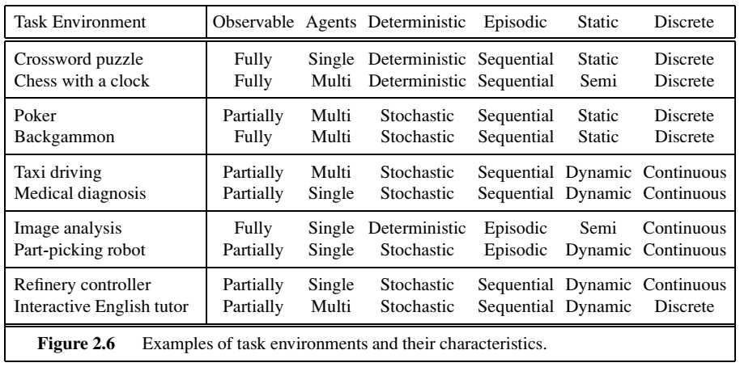
Intelligent agents

Slide 18
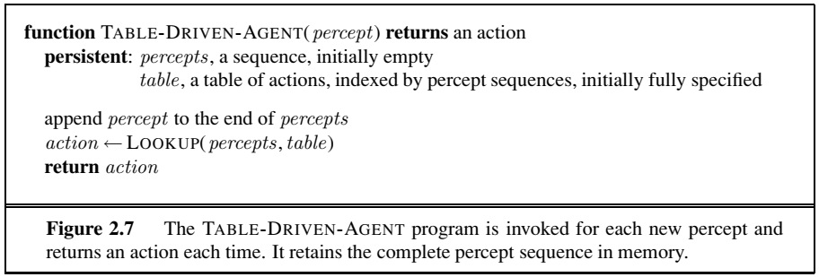
Intelligent agents
The agent programs take the current percept as input from the sensors and return an action to the actuators.
The agent program takes just the current percept as input because nothing more is available from the environment; if the agent’s actions need to depend on the entire percept sequence, the agent will have to remember the percepts.

Slide 19
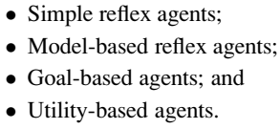
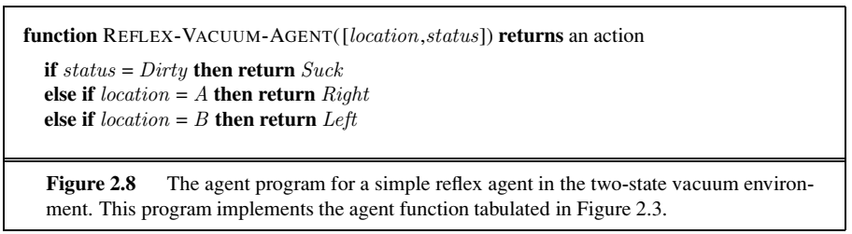
Intelligent agents

Slide 20

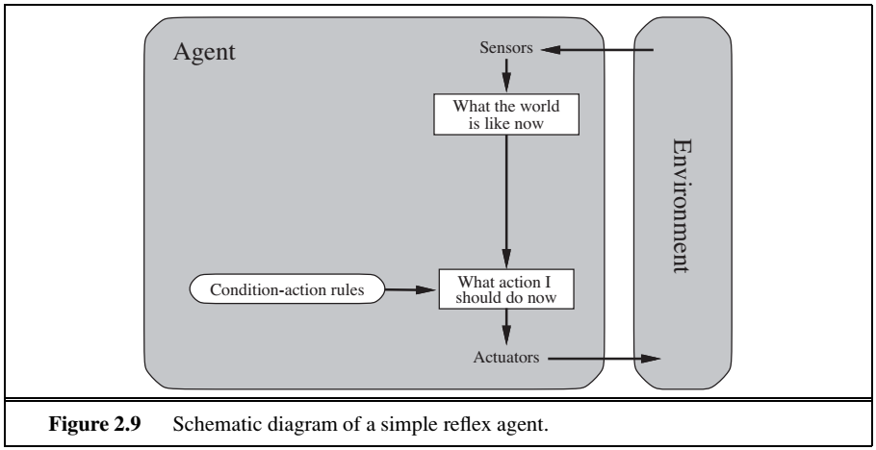
Intelligent agents
These agents select actions on the basis of the current percept, ignoring the rest of the percept history.

Slide 21
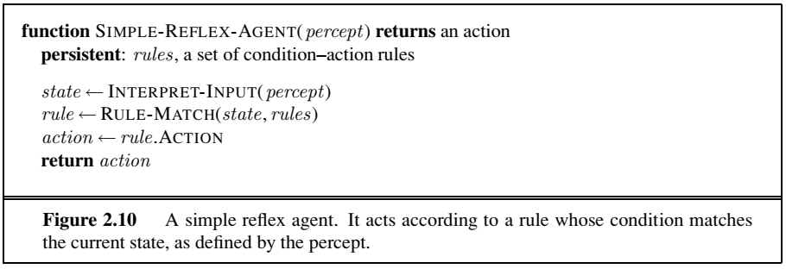
Intelligent agents

Slide 22
Intelligent agents
The most effective way to handle partial observability is for the agent to keep track of the part of the world it can’t see now.
That is, the agent should maintain some sort of internal state that depends on the percept history and thereby reflects at least some of the unobserved aspects of the current state.
For the braking problem, the internal state is not too extensive— just the previous frame from the camera, allowing the agent to detect when two red lights at the edge of the vehicle go on or off simultaneously. First, we need some information about how the world evolves independently of the agent—for example, that an overtaking car generally will be closer behind than it was a moment ago.
Second, we need some information about how the agent’s own actions affect the world—for example, that when the agent turns the steering wheel clockwise, the car turns to the right, or that after driving for five minutes northbound on the freeway, one is usually about five miles north of where one was five minutes ago.
This knowledge about “how the world works”—whether implemented in simple Boolean circuits
or in complete scientific theories—is called a model of the world.
An agent that uses such a MODEL-BASED model is called a model-based agent.

Slide 23
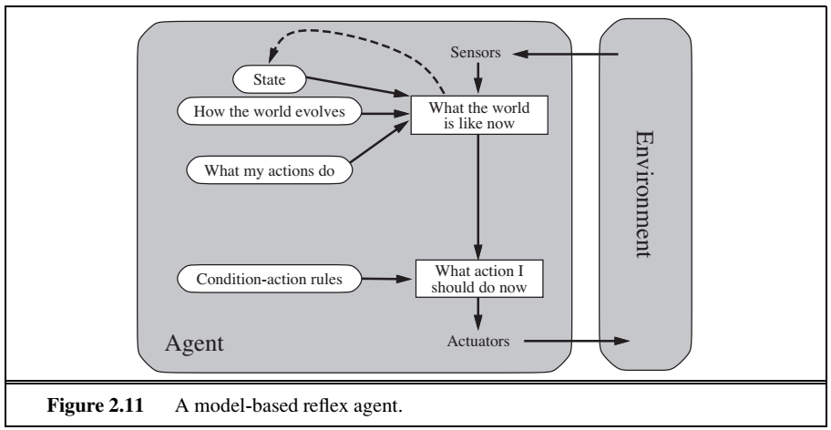
Intelligent agents

Slide 24
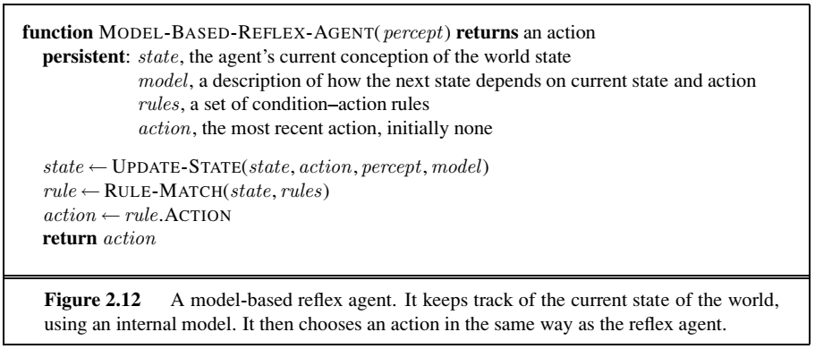
Intelligent agents

Slide 25
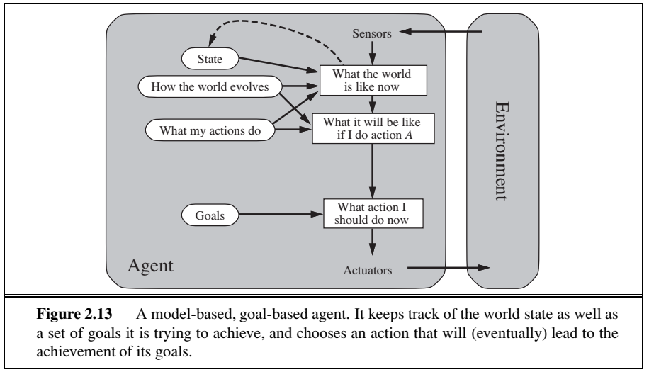
Intelligent agents

Slide 26

Intelligent agents
The agent needs some sort of goal information that describes situations that are desirable.
For example, being at the passenger’s destination.
The agent program can combine this with the model (the same information as was used in the model based reflex agent) to choose actions that achieve the goal.

Slide 27

Intelligent agents
Goals alone are not enough to generate high-quality behavior in most environments.
Goals just provide a crude binary distinction between “happy” and “unhappy” states.
A more general performance measure should allow a comparison of different world states according to exactly how happy they would make the agent. Because “happy” does not sound very scientific, economists and computer scientists use the term utility instead.
An agent’s utility function is essentially an internalization of the performance measure. If the internal utility function and the external performance
measure are in agreement, then an agent that chooses actions to maximize its utility will be rational according to the external performance measure.

Slide 28
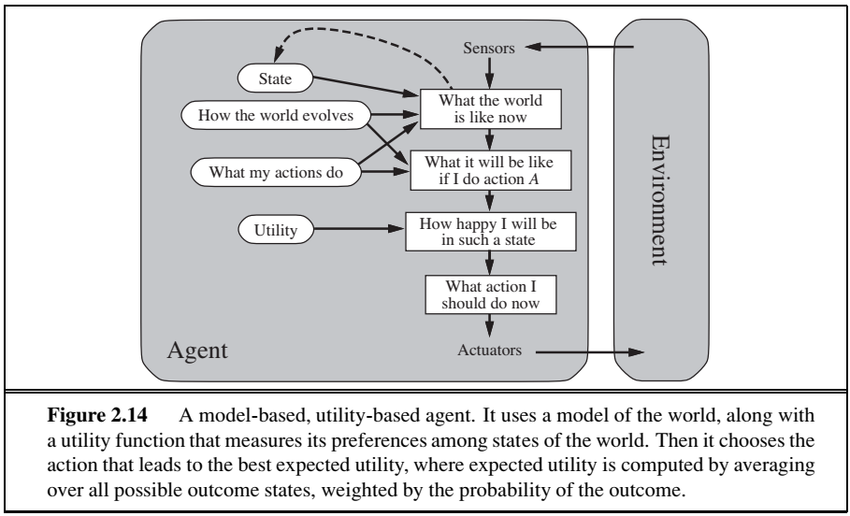
Intelligent agents

Slide 29

Intelligent agents
A learning agent can be divided into four conceptual components, as shown in Figure 2.15.
The most important distinction is between the learning element, which is responsible for making improvements, and the performance element, which is responsible for
selecting external actions.
The performance element is what we have previously considered to be the entire agent: it takes in percepts and decides on actions.
The learning element uses feedback from the critic on how the agent is doing and determines how the performance element should be modified to do better in the future.

Slide 30
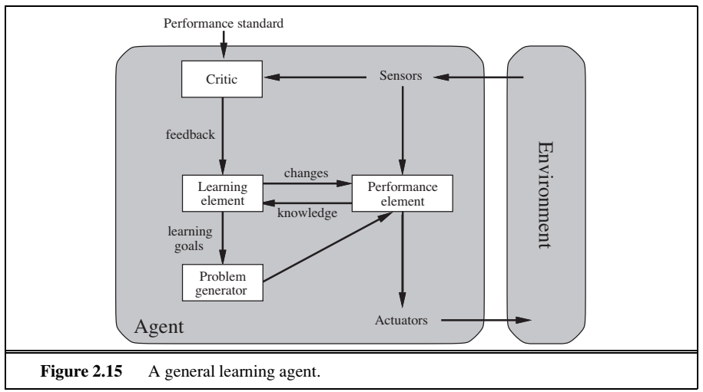
Intelligent agents

Slide 31
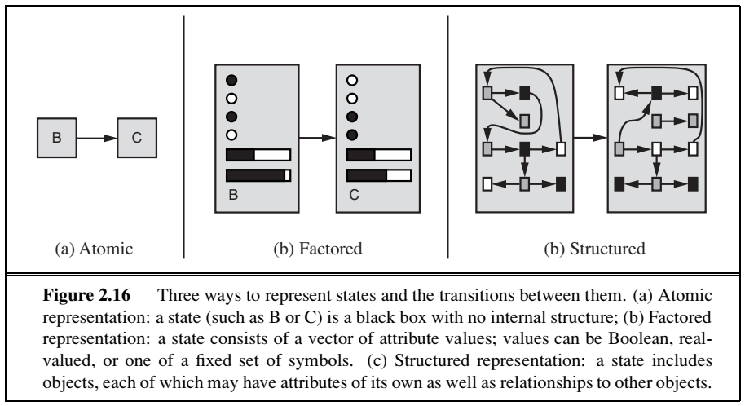
Intelligent agents

Slide 32
Intelligent agents
In an atomic representation each state of the world is indivisible—it has no internal structure. A factored representation splits up each state into a fixed set of variables or attributes, each of which can have a value.
The algorithms underlying search and game-playing, Hidden Markov models, and Markov decision processes, all work with atomic representations.
Many important areas of AI are based on factored representations, including constraint satisfaction algorithms, propositional logic, planning, Bayesian networks, and the machine learning algorithms.
A structured representation, in which objects such as cows and trucks and their various and varying relationships can be described explicitly.
Structured representations underlie relational databases and first-order logic , first-order robability models, knowledge-based learning and much of natural language understanding.
In fact, almost everything that humans express in natural language concerns objects and their relationships.

Slide 33
Thank you

